Slide 1
Clip-On Book Notifier
Weisheng Zhang, Xiaolei Luo, Richard Levin, Benjamin Bowen, Akshara Sundararajan, Matthew McMahan, Andrew Canafe
Notes:
Richard

Slide 2
Unmet Need
Stacy, a client
A student overwhelmed with the quarter system
Can’t help but forget to do her readings
Clip-On Book Notifier, our product
Reminds Stacy when to open her book(s)
Notes:
Richard (unmet need focuses on simplicity)

Slide 3
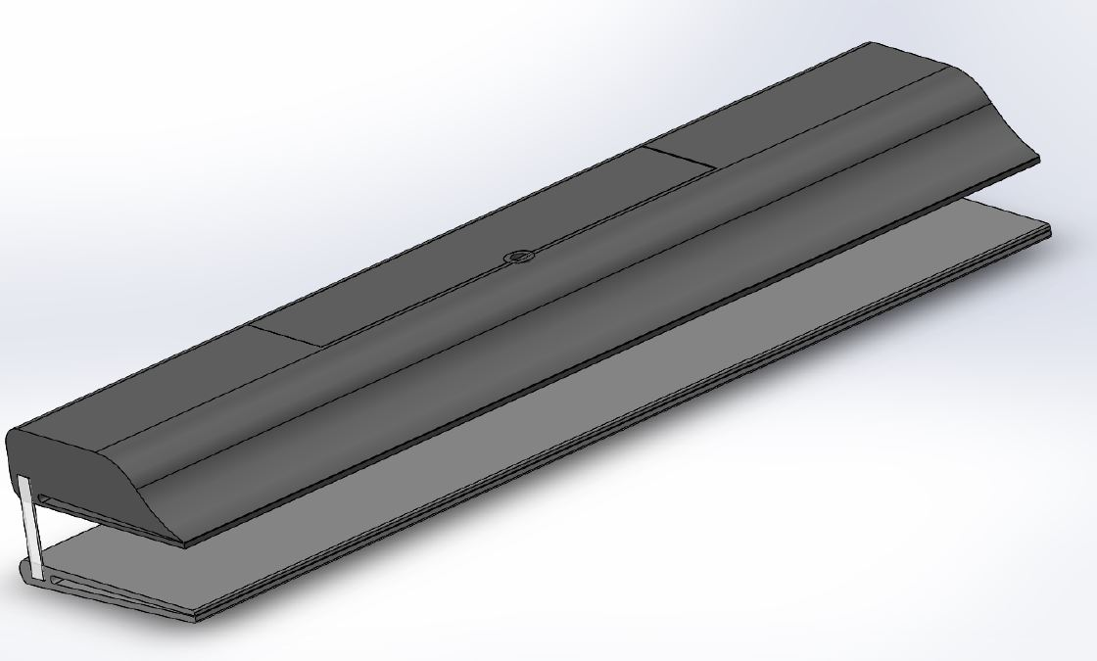
Product Overview
Notes:
Our solution is a plastic “Notebook Notifier”, with Low Energy Bluetooth and Li-ion battery technology, allowing us to organize a user’s various books and send reminders to read

Slide 4

How would you use it?
Clip-On Book Notifier
Unpackage & Download app
Pull tab to power on device
Scan QR code
In-app, enter preferences/details for the attached book:
Book Title
Frequency of Reminders
Place clip & get notified to read!
Title - Notification Freq
Math 32A - 2 days
Harry Potter - 7 days
CS 31 - 5 days
Wireframe

Slide 5
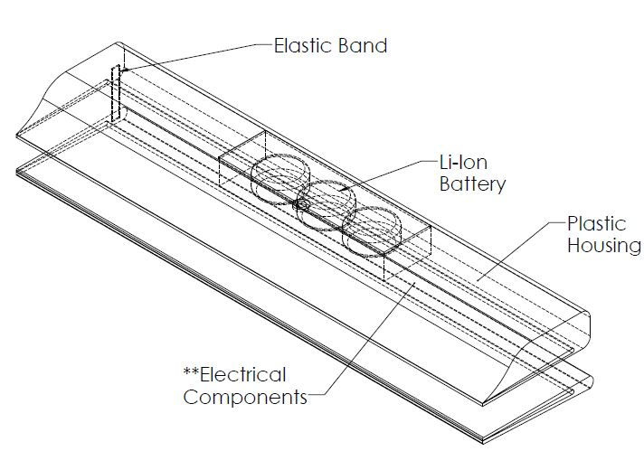
How would it work?
Leveraging existing technology!
App
React Native for Android/iOS support
Bluetooth Low Energy API
Hardware
Bluetooth Low Energy Chip
Li-ion Button Cell Batteries
QR Code

Slide 6
Key Attributes Matrix
Top Customer Driven Attributes |  | Clip-on Book Notifier | Uxcell Magnetic Sensors | Droplet | Aumi Mini | Noopel Door + Window Alarm | Klikkit
Notification accuracy/ Reliability | 30% | 9 | 6 | 9 | 9 | 9 | 9
Simplicity | 25% | 9 | 8 | 7 | 7 | 7 | 8
Portability | 25% | 10 | 6 | 9 | 9 | 7 | 9
Compatibility | 20% | 9 | 6 | 9 | 7 | 7 | 8
Price in USD |  | $12.00 | $12.41 | $19.00 | $24.00 | $13.69 | $19.50
Rating (out of 10) |  | 9.25 | 6.5 | 8.5 | 8.1 | 7.6 | 8.55

Slide 7
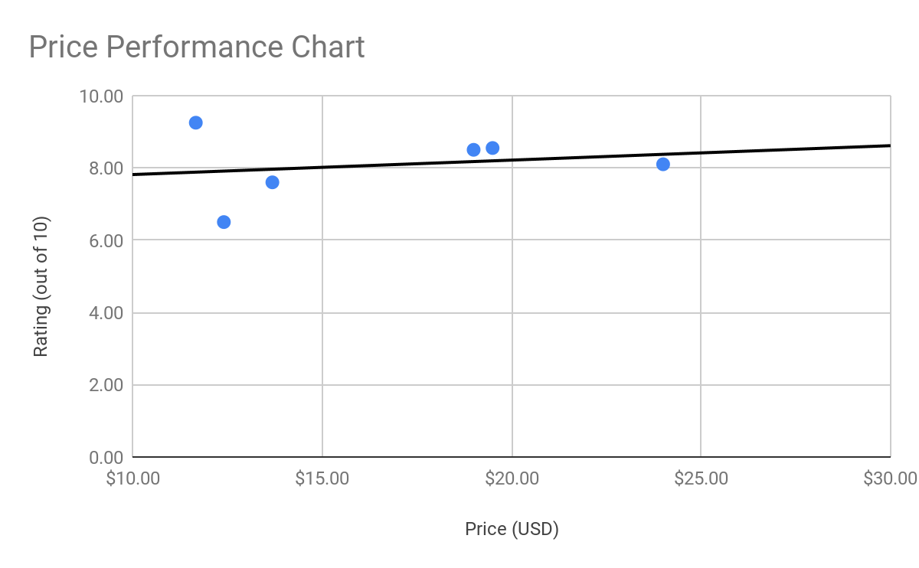
Price Performance Chart
Our product
Droplet
Klikkit
Aumi mini
Noopel door + window alarm
Uxcell magnetic sensors
Notes:
(Max)

Slide 8
Program Risk and Mitigation
Foreign Body Ingestion/Choking Hazard
Don’t offer in bright colors to detract from children
Using High Density Polyethylene so breaks don’t occur
Have screw for battery cover for child safety
Advise user to keep out of the reach of children
Potentials Cuts
Using High Density Polyethylene so the product doesn’t break on high stress; mitigates cracking
Disconnection
Give a reminder to customer to put product in area that they go frequently
App sends notifications saying it’s disconnected to remind to user to get in range
Notes:
Matty Ice!

Slide 9
Financial Summary

Slide 10
Total Development Cost - $318,210.
Labor Cost:
32 (total weeks for Jr ME) * 1 (total number of Jr Me) * 1200 (salaries per week) = $38,400.
32 (total weeks for Jr EE) * 2 (total number of Jr EE) * 1400 (salaries per week) = $89,600.
19 (total weeks for Jr CS) * 3 (total number of Jr CS) * 1300 (salaries per week) = $74,100.
Total: $202,100.
Non-Recurring Engineering (NRE):
Industrial Design: $5000.
Tooling: $5000.
Total: $10,000.
Capital Equipment:
Plastic Mold: $12,000.
Total: $12,000.
Risk Inventory:
Batteries(120000): $22920.
Plastic Casing/Clip(80000): $800.
Elastic Band(40000): $1665.
CMOS Transistors(240000): $4800.
PCB Printing(40000): $63925.
Total: $94,110.

Slide 11
Bill of Materials (BOM)/ Component Breakdown
Component Level 1 | QTY | Unit | Unit Cost ($)
AG13 LR44 Batteries | 3 | EA | 0.191
Plastic Casing/Clip | 2 | EA | 0.01
Elastic Band | 1(2) | EA(Inch) | 0.041625
CMOS Transistors | 6 | EA | 0.02
PCB printing (including bluetooth chip) | 1 | EA | 1.59809
*Total Cost: $2.33 *Total Weight: 34.6g

Slide 12
Break Even Calculation
First Calculation:
Total Development Cost = $318,210.
BOM = $2.33.
Price of Product = $12.
Break Even Number = $318210 / ($12 - $2.33)
= 32,907 units.
Single Iteration on Minimal Order Quantity (MOQ):
Batteries(21279): $4065.
Plastic Casing/Clip(14186): $142.
Elastic Band(7093): $296.
CMOS Transistors(42558): $852.
PCB Printing(7093): $11336.
New Risk Inventory = $16,691.
New Total Development Cost = $240,791.
New Break Even Number = $240791 / ($12 - $2.33) = 24,901 units.

Slide 13
Key Milestones
Research
Equipment/Part Ordering
Hardware Quality Testing
Release
Software Dev
Manufacturing
Integration/Testing/Bug Fixes
Initial Specifications Hardware Design
Ordering Materials Custom Equipment
Durability, Strength Tests
First-Round Prototype in Market
Month | 1 | 2 | 3 | 4 | 5 | 6 | 7 | 8 | 9 | 10 | 11
Develop Software - Agile
Building Product
Combining Hardware and Software
Notes:
Gather customer feedback/usage data, hone-in key attributes valued by customer

Slide 14
Summary & Recommendation
Provides a convenient way to remind you to read
Failure mode risks have already been addressed
Straightforward implementation leveraging existing Bluetooth
Uses React Native for both iOS and Android compatibility
Low recurring cost using Lithium-ion button cell batteries
Requesting $320,000 in seed round funding.

